Slide 1
Ministering to Survivors of Sexual Abuse
WELS National Conference on Lutheran Leadership
January 20, 2026
Steven Lange

Slide 2
Before we begin…
What we will talk about today is unavoidably difficult. There is no easy or painless way to talk about sexual abuse.
As we progress through this presentation, care for yourself and those who are around you.
To my fellow survivors: You are safe here. But if you begin to feel unsafe for any reason, do not hesitate to do what you need to do to feel safe.

Slide 3
Part 1: Sexual Abuse – Prevalence, Definition, Perpetrators, and Effects

Slide 4
Who am I?
I am a child of God, husband, father, pastor, friend…and a survivor of childhood sexual abuse.
I grew up in a Christian home.
I grew up in New Ulm, MN, a small, safe town.
I went to church regularly. I attended a Christian grade school.
I was sexually abused when I was fourteen years old.
The effects of that abuse tormented me for nearly four decades.
In 2021, my wife convinced me to start seeing a therapist. It was then that I realized that what happened to me was sexual abuse.
Ever since then, I’ve been healing, and I will be healing until Jesus takes me home to heaven.

Slide 5
I am not alone.
1 out of every 4 girls experiences sexual abuse.
1 out of every 6 boys experiences sexual abuse.
Nearly 70% of all reported sexual assaults (including assaults on adults) occur to children aged 17 and under.
85% of children who experience abuse never report the abuse.
Think about those statistics. Think about your group of friends. Think of the people sitting with you in the pew at church. Think of the children in your classrooms. Think of your children’s friends. Think of the pastors and teachers you know. Abuse survivors are all around you. You know survivors, whether you realize it or not.

Slide 6
What is sexual abuse?
Sexual abuse refers to sexual acts committed against a child, an adolescent, or a vulnerable adult by someone in a position of power, authority, or perceived authority.
Sexual abuse can take place between a child and an adult or between a child and another (often older) child.
Sexual abuse can involve physical, sexual contact between the perpetrator and the child. But it also can happen without any physical contact, such as when a perpetrator exposes a child to sexual images or situations.

Slide 7
What is sexual abuse?
Sexual abuse often involves a power differential. That power differential can be one of physical strength or authority. It can be emotional or psychological. It can be a difference in age or maturity. It can happen as a result of trust or familiarity. It can be anything that allows the abuser to take advantage of the person being abused and makes the person being abused feel powerless to stop what is happening.
Children who are abused often do not recognize what happened to them as abuse.

Slide 8
Who perpetrates the abuse?
More than 90% of abusers are people that the children know, love, and trust.
30-40% of children who are abused experience abuse from a family member.
50% of children who are abused experience abuse from someone outside the family whom they know and trust.
This is not a “stranger danger” problem. Abusers exploit the trusting relationship they have with children, not only to carry out the abuse, but also to keep the abuse hidden.
This also is not just a “Catholic” or “Baptist” problem. In 2025 alone, there were at least six WELS churches or schools where a called worker or employee was arrested, charged, or convicted of crimes against a child.

Slide 9
How does sexual abuse affect a survivor?
Sexual abuse affects each survivor differently. But the various effects demonstrate the many ways in which sexual abuse robs a person of safety.
Loss of physical safety
Physical coercion
Physical injuries

Slide 10
How does sexual abuse affect a survivor?
Loss of emotional safety
Safe places no longer feel safe.
Thoughts no longer are safe.
Depression
Flashbacks
Their own body no longer feels safe.
Dissociation
Eating disorders
Gender dysphoria
Body dysmorphia

Slide 11
How does sexual abuse affect a survivor?
Loss of emotional safety (continued)
Sleep isn’t safe.
Sleep disorders
Disturbing dreams
Relationships don’t feel safe.
Inability to trust others
Feeling threatened by those who pose no threat
Problems in their sexual relationship with their spouse
They no longer are safe toward themselves.
Self-harm
Suicidal thoughts and attempts

Slide 12
How does sexual abuse affect a survivor?
Their body reacts to all this loss of physical and emotional safety.
Post-traumatic stress disorder
Panic attacks
Loss of spiritual safety
Guilt: “What I did is so wrong that God could never forgive me.”
Shame: “I am evil. I am disgusting. God could never love someone as horrible as me.”
“Where was God when this was happening to me? And why didn’t he stop it?”

Slide 13
Survivors of sexual abuse need safety.
In a 2019 survey conducted by Lifeway Research, only 47% of Lutheran respondents strongly agreed that their church is a good place for a child sexual abuse victim to find healing (Sexual Misconduct and Churchgoers: National Survey of Protestant Churchgoers, Lifeway Research, 2019).
Other research has shown that women, especially, are leaving the church, not necessarily because of a loss of faith, but because of the failure of churches to properly address situations of abuse.
We need to make ourselves and our churches the safe places that abuse survivors need.

Slide 14
Interlude: We serve a Savior who was abused.

Slide 15
We serve a Savior who was abused.
“The Bible also tells us Jesus endured multiple forms of trauma. As a child, Jesus narrowly escaped child homicide (Matt 2:16-18). As a man, Jesus suffered emotional abuse (Matt 27:39-41; Mark 15:15-20), physical abuse (e.g., John 18:22-24; John 19:1), torture (e.g., Matt 27:32-44), and murder (e.g., Matt 27:45-50). Since he was stripped of his clothing, and crucifying victims naked was part of the sexual humiliation Roman soldiers forced victims to endure, our Lord suffered sexual exploitation as that term is understood today.” (Victor Vieth, “The Need for a Trauma-Informed Lutheran Theology: A Case Study on Lutheran Study Bibles”)

Slide 16
We serve a Savior who was abused.
“What sort of abuse is stripping and forced exposure if not sexual abuse? Public stripping, enforced nakedness, and sexual humiliation constitute sexual abuse because they are attacks on sexual identity and sexual vulnerability…They derive their power and impact because they were understood—and are still understood—to have a sexual dimension. To name them only as abuse is to mischaracterize what has happened, which serves to distort the reality of Jesus’ experience.” (Jamye R. Reaves & David Tombs, “Introduction: Acknowledging Jesus as a Victim of Sexual Abuse,” in Jayme R. Reaves, David Tombs, & Rocio Figueroa, eds., When Did We See You Naked? Jesus as a Victim of Sexual Abuse (SCM Press: London, UK 2021), 3.)

Slide 17
We serve a Savior who was abused.
Our Savior, who himself was abused, loves and cares for survivors of abuse. Our Savior’s love for the “least of these” leads us to love and care for them as well.
“‘For I was hungry and you gave me something to eat; I was thirsty and you gave me something to drink; I was a stranger and you took me in; I was naked and you clothed me; I was sick and you took care of me; I was in prison and you visited me.’ “Then the righteous will answer him, ‘Lord, when did we see you hungry and feed you, or thirsty and give you something to drink? When did we see you a stranger and take you in, or without clothes and clothe you? When did we see you sick, or in prison, and visit you?’ “And the King will answer them, ‘Truly I tell you, whatever you did for one of the least of these brothers and sisters of mine, you did for me.’” (Matthew 25:35-40)

Slide 18
Part 2: Helping Survivors Carry Their Burden

Slide 19
Carry each other’s burdens.
Carry each other’s burdens, and in this way you will fulfill the law of Christ (Galatians 6:2).

Slide 20
What does it mean to “carry each other’s burdens”?
It does NOT mean that you can take the burden away from the survivor. You can’t undo the trauma. The survivor understands that. They’re not looking for you to take the trauma away. They’re just looking for you to help them carry it.
It means that you are willing to walk alongside the survivor. You can’t help someone carry a burden from across the room. You need to walk alongside them.
It means that you are willing to put effort into helping carry the burden. This won’t be easy.
It means that you are willing to get down in the muck and the mess—and get messy yourself. You can’t help someone carrying a burden through a mud pit unless you’re willing to get into the mud pit too.
It means that you are willing to be extremely patient with the survivor.
It means that you are willing to help carry this burden for the long haul.

Slide 21
Pastors, take the lead in making your congregation safe for survivors.
Establish child protection policies in your congregation that reflect best practice.
The Child Safeguarding Policy Guide for Churches and Ministries, by Basyle (Boz) Tchividjian and Shira M. Berkovits
“Preventing Abuse in Christian Organizations That Serve Youth: Ten Policies to Create Safer Environments,” by Shira M. Berkovits
“Suffer the Children: Developing Effective Church Policies on Child Maltreatment,” by Victor I. Vieth
Freedom for the Captives, https://freedomforcaptives.com/
Take advantage of training resources, such as the Keeping Faith course, provided by the Center for Faith and Child Protection. The next course takes place April 28-29, 2026. The registration link is in Appendix 2: Resources under Online Resources.

Slide 22
Pastors, take the lead in making your congregation safe for survivors.
Know that you have survivors in your flock. You may not yet know who they are. But they’re there. They’re struggling. They’re hurting. They’re ashamed. They don’t know if you’re safe for them to go to.
Know that because you are a man, a survivor (especially a female survivor) may view you as de facto unsafe.
Do everything you can to demonstrate that you are safe, even before the survivor comes to you.
Educate yourself on the effects of trauma.
A place to start: https://www.cdc.gov/aces/about/index.html
Deep as the Sea: Letters to Survivors of Trauma by Timothy C. Bourman (NPH)

Slide 23
Pastors, take the lead in making your congregation safe for survivors.
Do everything you can to demonstrate that you are safe, even before the survivor comes to you (continued).
Pursue a trauma-informed Lutheran theology.
“The Need for a Trauma-Informed Lutheran Theology: A Case Study on Lutheran Study Bibles” by Victor I. Vieth
“Toward a More Trauma-Informed Church: Equipping Faith Communities to Prevent and Respond to Abuse” by Pete Singer
Show in your teaching and preaching that it’s safe to talk about sexual matters in church. Let the gospel predominate when you talk about sex. (Free from Shame—A Biblical Study of Human Sexuality by Steven L. Lange, to be published, God willing, by NPH in October 2026)
Talk about abuse in your preaching and teaching.
Be willing to be vulnerable yourself.

Slide 24
Ways that you can help a survivor carry their burden
When the survivor first shares their story with you:
Listen to them. Just let them talk.
Believe them. Satan often keeps survivors suffering in silence by convincing them that no one will believe them. Prove the falsehood of Satan’s lie.
Tell them how sorry you are that this happened to them. They know it’s not your fault. But hearing you express your sincere sorrow over what they experienced helps bring healing.
Recognize the courage it took for them to share this with you. Let them know how honored you are to share this burden with them.
Love them unconditionally and treat them just as you did before they shared their story with you.

Slide 25
Ways that you can help a survivor carry their burden
Now that you are sharing this burden with the survivor:
Continue listening. Be a safe place for the survivor to get out all the emotional poison that has accumulated over the years.
Be prepared to hear difficult details. Be sure to let the survivor know that no matter what they share with you, you will always love them the same. What happened to them, no matter how awful, does not define them or change the way you see them.
Recognize that the survivor understands there are no easy answers. Don’t feel obligated to give an answer to every question the survivor asks. Sometimes there are no good answers. Sometimes, all they need is someone to listen, weep with them, and say, “I am so sorry that happened to you.”

Slide 26
Ways that you can help a survivor carry their burden
Now that you are sharing this burden with the survivor (continued):
Repeatedly, patiently, and persistently share with the survivor these key truths. (See Appendix 1 for a fuller explanation of these key truths.)
“You are God’s child.”
“This is not your fault.”
“You are not alone.”
“In Jesus, you are safe.”
“Your body is still God’s good creation.”
“God will help you believe these things, even if you find them hard to believe.”

Slide 27
Ways that you can help a survivor carry their burden
Now that you are sharing this burden with the survivor (continued):
Assure the survivor that you are with them for the long haul. Healing from sexual abuse is not a quick or easy process. It can take months, years, or a lifetime. Let your Christian brother or sister know that you are there for them for as long as it takes. Then make good on that commitment. You will be blessed yourself, even as you are a blessing to your healing brother or sister in Christ.
Encourage the survivor to seek help. Encourage them to talk to their pastor. Encourage them to work with a Christian counselor. If appropriate, encourage them to speak with law enforcement. Go with them if that will help. Show them that they don’t have to work through the effects of what they’ve experienced all by themselves.

Slide 28
Be prepared to refer the survivor to a mental health professional.
I strongly encourage you ALWAYS to be prepared to refer a survivor of sexual abuse to a mental health professional.
As a pastor, you have an essential spiritual role to play in the survivor’s journey of healing.
But healing from sexual abuse is more than a spiritual journey. It’s also a mental, emotional, and even physical journey.
As a pastor, you are not trained to deal with every aspect of a survivor’s healing all by yourself.
If a survivor comes to you and shares their story, that usually means there are deeper issues at play. Help the survivor take advantage of every available resource to help them heal.

Slide 29
Be prepared to refer the survivor to a mental health professional.
Have a list of mental health professionals ahead of time.
Christian Family Solutions
Local providers, especially if you are outside the WELS heartland.
As much as possible, build a relationship with any mental health professionals your brother or sister in Christ goes to.
View any mental health professional that your brother or sister in Christ goes to as a partner, not a rival. They are working together with you to bring healing to this hurting child of God.
“Coordinating Pastoral Care of Survivors with Mental Health Providers,” by Pete Singer

Slide 30
A few other things to keep in mind.
Pastors, be aware of the possibility of sexual abuse in other counseling situations as well. (E.g., intimacy problems in marriage could have their root in sexual abuse the husband or wife experienced.)

Slide 31
A few other things to keep in mind.
Understand the power of lies implanted during trauma.
Lies implanted in a person’s mind during a traumatic situation are engraved extremely deeply in a person’s consciousness. It will take a lot of work, time, patience, and persistence to overcome those lies.
New beliefs (psychologically speaking) develop over time through positive experiences. These new, positive beliefs will take much longer to develop than it took for the trauma-induced lies to take hold.

Slide 32
A few other things to keep in mind.
Understand the power of lies implanted during trauma (continued).
Because of this, you cannot expect a survivor to hear the truth once and immediately take it to heart. Even if they understand what you’re saying intellectually, their emotions and the lies implanted in their mind will make it extremely hard for them to believe that what you’re saying is true.
So, be patient. Know that this will take much more than a few meetings and a well-placed Bible passage. Be firm in standing on the truth. But be patient with your brother or sister in Christ as they struggle truly to believe what they intellectually know to be true.

Slide 33
Conclusion
Brothers and sisters in Christ, fellow pastors, know that we’re here. See us. Love us. Help us feel safe. Be for us the safe place that we need. Point us to Jesus. Be willing to get down in the muck and the mud with us and help us carry this burden. You will be blessed as you are the loving heart, the listening ears, the weeping eyes, the wet shoulders, the strong embracing arms, and the gospel-speaking mouth of Jesus to us.

Slide 34
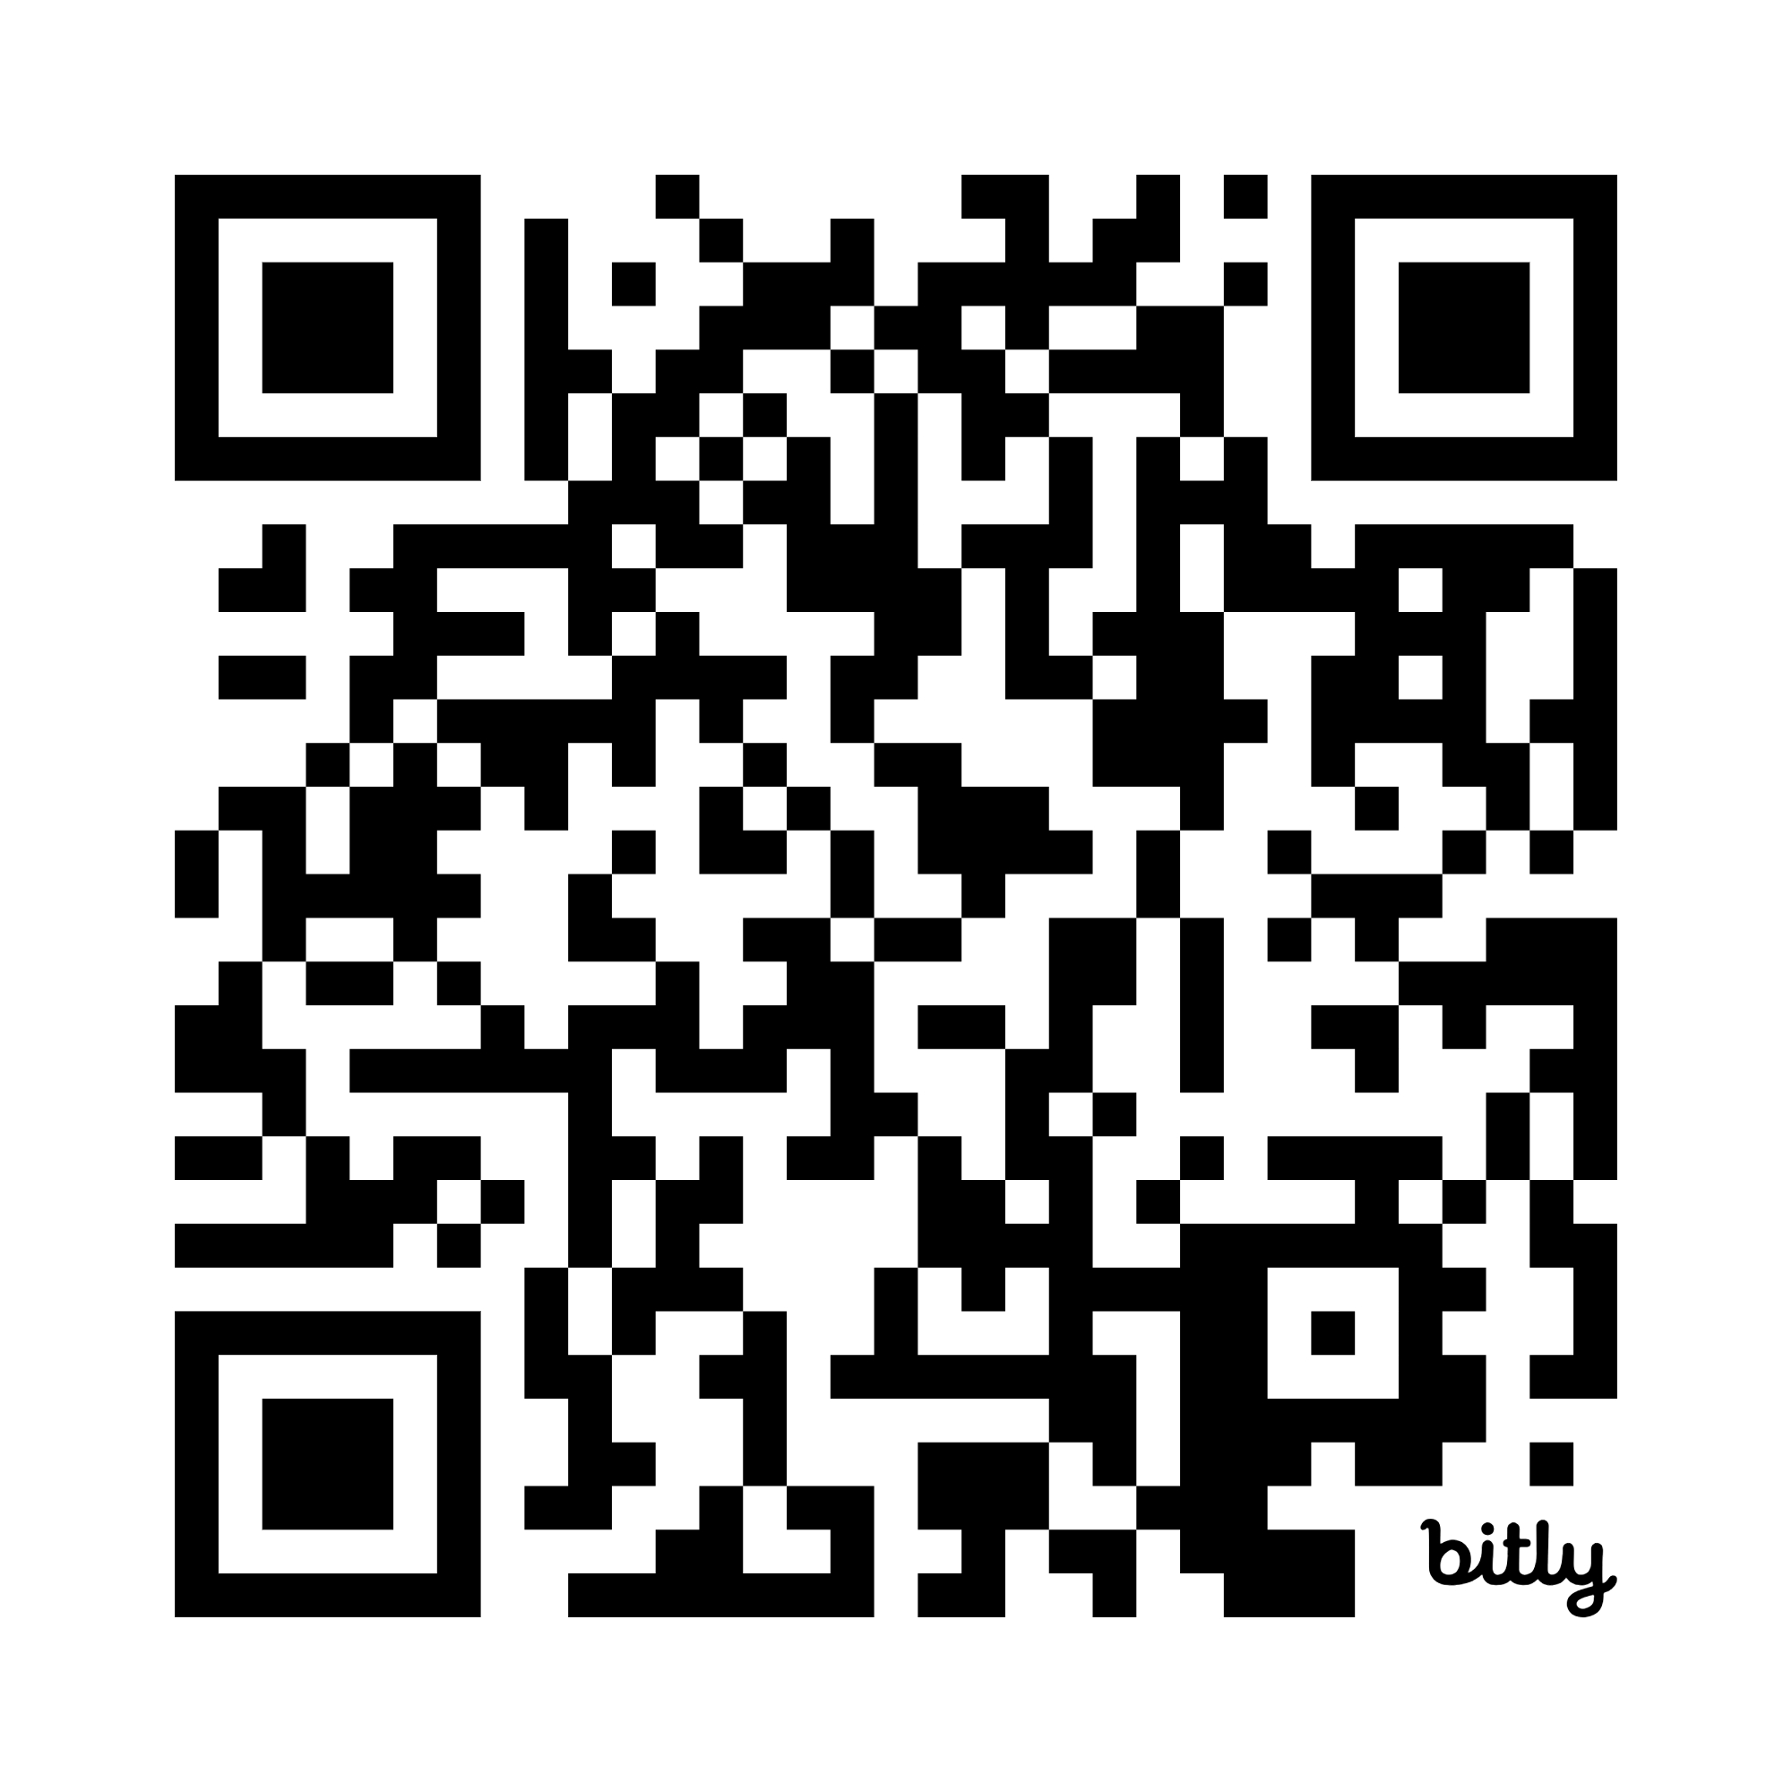
Resources
https://bit.ly/LangeMSSA

